Slide 1

Learning Outcome 3
Web Application development with python
Prof. Dr. Rashmi gupta
Rashmi.gupta@kristiania.no

Slide 2
Django Learning Journey
Introduction to Django
Discover the powerful Python framework that makes web app development faster and easier.
Step-by-Step Setup
Learn how to install Django and create your very first project, hassle-free.
Build a CRUD Application
Create a project where you can add, read, update, and delete data like a real-world app.
Designing with Templates
Craft beautiful HTML templates and connect them seamlessly with your Django project.
Mastering Template Tags
Use Django template tags to dynamically insert data into your HTML pages.
QuerySet Magic
Learn how to extract, filter, and sort data from your database with ease.
PostgreSQL Integration
Set up and connect a PostgreSQL database for scalable, production-ready applications.
Deployment Made Simple
Deploy your Django project to the world and make it accessible online.

Slide 3
Extra Resource Material
🔗 Django Official Site: https://www.djangoproject.com/
🔗 Python Official Site: https://www.python.org/
🔗 Python Django Tutorial by Dave Gray: Youtube Tutorial Guide

Slide 4
Django
Django is a free and open-source, back-end server-side, Python-based web framework that follows the model–template–views (MTV) architectural pattern.
It is maintained by the Django Software Foundation (DSF), an independent organization established in the US as a non-profit.
Django takes care of the difficult stuff so that you can concentrate on building your web applications.
Django emphasizes the reusability of components, also referred to as DRY (Don't Repeat Yourself), and comes with ready-to-use features like
login system,
database connection and
CRUD operations (Create Read Update Delete).
Django is especially helpful for database driven websites.
Some well-known sites that use Django include Instagram, Mozilla, Disqus, Bitbucket, Nextdoor and Clubhouse.
We will follow this tutorial to deeply understand about Django.. HERE. Additionally, you refer Python Django Tutorial by Dave Gray: Youtube Tutorial Gui

Slide 5
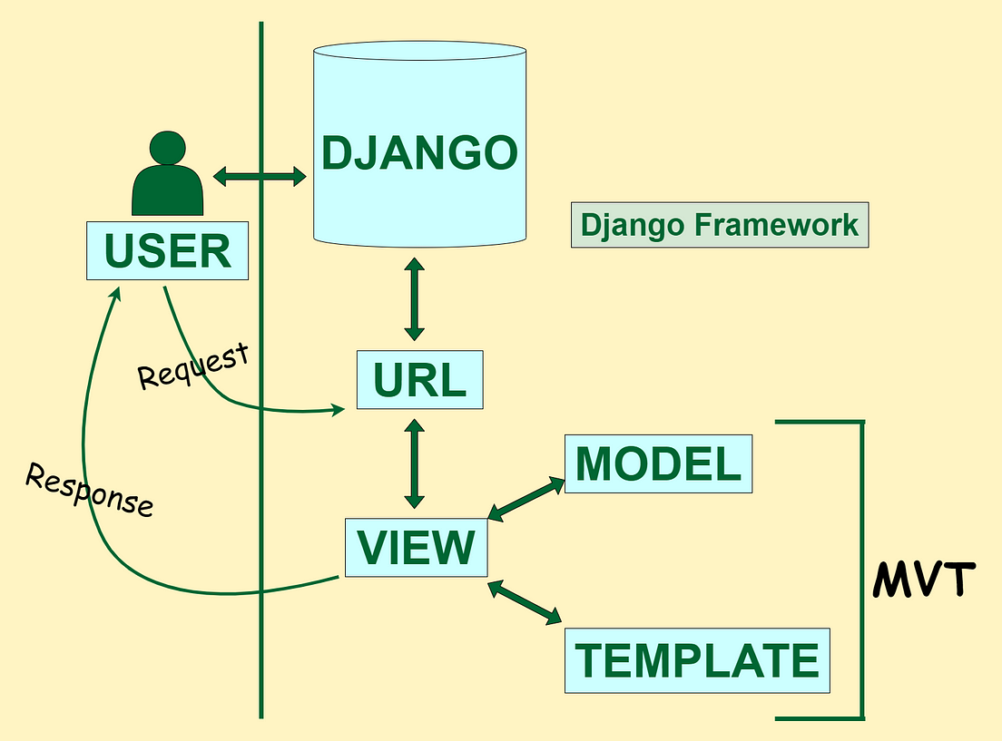
How does Django Work?
Django follows the MVT design pattern (Model View Template).
Model - The data you want to present, usually data from a database.
View - A request handler that returns the relevant template and content - based on the request from the user.
Template - A text file (like an HTML file) containing the layout of the web page, with logic on how to display the data.

Slide 6
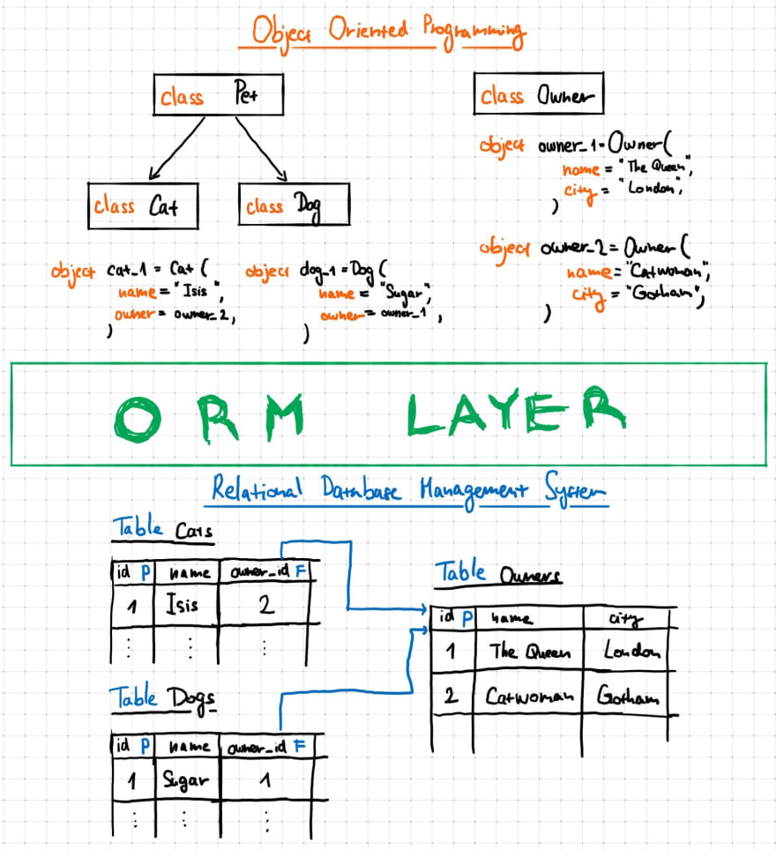
Model
The model provides data from the database.
In Django, the data is delivered as an Object Relational Mapping (ORM), which is a technique designed to make it easier to work with databases.
ORM stands for object-relational mapping, where objects are used to connect the programming language on to the database systems, with the facility to work SQL and object-oriented programming concepts.
The most common way to extract data from a database is SQL. One problem with SQL is that you have to have a pretty good understanding of the database structure to be able to work with it.
Django, with ORM, makes it easier to communicate with the database, without having to write complex SQL statements.
The models are usually located in a file called models.py
Bonus: if you want to dig into understanding this figure in depth:

Slide 7
View
A view is a function or method that
takes HTTP requests as arguments,
imports the relevant model(s), and
finds out what data to send to the template, and returns the final result.
The views are usually located in a file called views.py

Slide 8
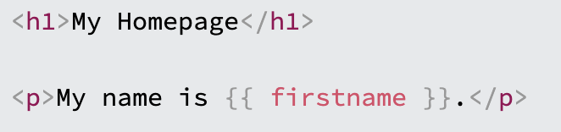
Template
A template is a file where you describe how the result should be represented.
Templates are often .html files, with HTML code describing the layout of a web page
Django uses standard HTML to describe the layout, but uses Django tags to add logic:
The templates of an application is located in a folder named templates.

Slide 9
URLs
Django also provides a way to navigate around the different pages in a website.
When a user requests a URL, Django decides which view it will send it to.
This is done in a file called urls.py

Slide 10
So, What is Going On?
When you have installed Django and created your first Django web application, and the browser requests the URL, this is basically what happens:
Django receives the URL, checks the urls.py file, and calls the view that matches the URL.
The view, located in views.py, checks for relevant models.
The models are imported from the models.py file.
The view then sends the data to a specified template in the template folder.
The template contains HTML and Django tags, and with the data it returns finished HTML content back to the browser.

Slide 11
Django Getting Started
To install Django, you must have Python installed, and a package manager like PIP.
PIP is included in Python from version 3.4.
Django Requires Python
To check if your system has Python installed, run this command in the command prompt: python --version
If Python is installed, you will get a result with the version number, like this: Python 3.11.4
If you find that you do not have Python installed on your computer, then you can download it for free from the following website: https://www.python.org/
PIP
To install Django, you must use a package manager like PIP, which is included in Python from version 3.4.
To check if your system has PIP installed, run this command in the command prompt: pip --version
If PIP is installed, you will get a result with the version number, for me on Mac this is like: pip 23.2.1 from /Users/rashmig/anaconda3/lib/python3.11/site-packages/pip (python 3.11)
If you do not have PIP installed, you can download and install it from this page: https://pypi.org/project/pip/
Virtual Environment
It is suggested to have a dedicated virtual environment for each Django project, and in the next slides, you will learn how to create a virtual environment, and then install Django in it.

Slide 12
Django - Create Virtual Environment
It is suggested to have a dedicated virtual environment for each Django project, and one way to manage a virtual environment is venv, which is included in Python.
The name of the virtual environment is your choice, here we will call it Djtest.
Type the following in the command prompt, remember to navigate to where you want to create your project:
Windows: py -m venv Djtest
Unix/MacOS: python -m venv Djtest
This will set up a virtual environment, and create a folder named ”Djtest" with subfolders and files, like this:
Then you have to activate the environment, by typing this command:
Windows: Djtest\Scripts\activate.bat
Unix/MacOS: source Djtest/bin/activate
Once the environment is activated, you will see this result in the command prompt:
Windows: (Djtest) C:\Users\Your Name>
Unix/MacOS: (Djtest) ... $
Note: You must activate the virtual environment every time you open the command prompt to work on your project.

Slide 13
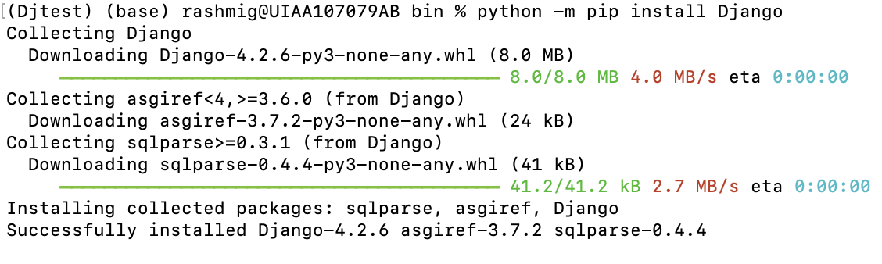
Install Django
Now, that we have created a virtual environment, we are ready to install Django.
Note: Remember to install Django while you are in the virtual environment!
Django is installed using pip, with this command:
Windows: (Djtest) C:\Users\Your Name>py -m pip install Django
Unix/MacOS: (Djtest) ... $ python -m pip install Django
That's it! Now you have installed Django in your new project, running in a virtual environment!
You can check if Django is installed by asking for its version number like this: (Djtest) C:\Users\Your Name>django-admin –version
Now you are ready to create a Django project in a virtual environment on your computer.

Slide 14
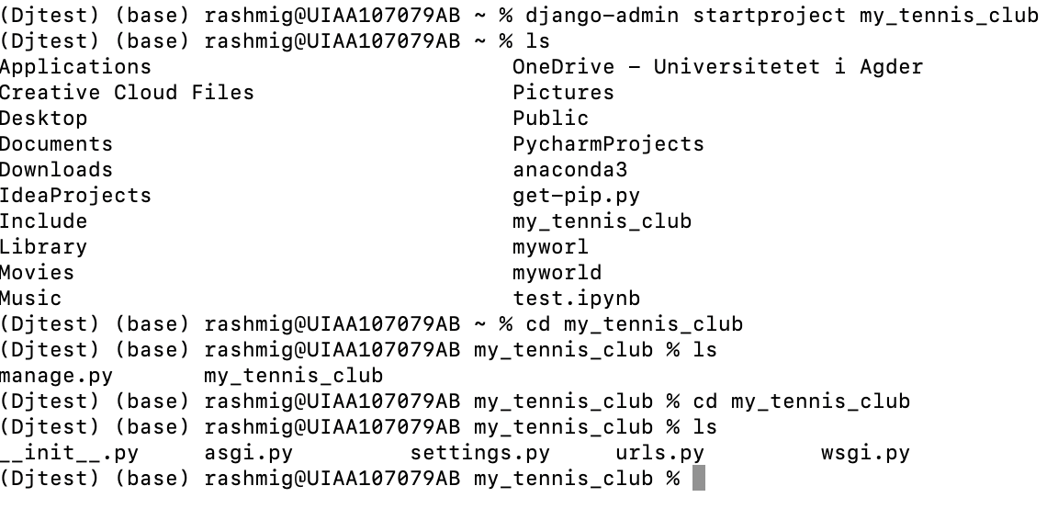
My First Django Project
Once you have come up with a suitable name for your Django project, like mine: my_tennis_club, navigate to where in the file system you want to store the code (in the virtual environment), and run this command in the command prompt: django-admin startproject my_tennis_club

Slide 15
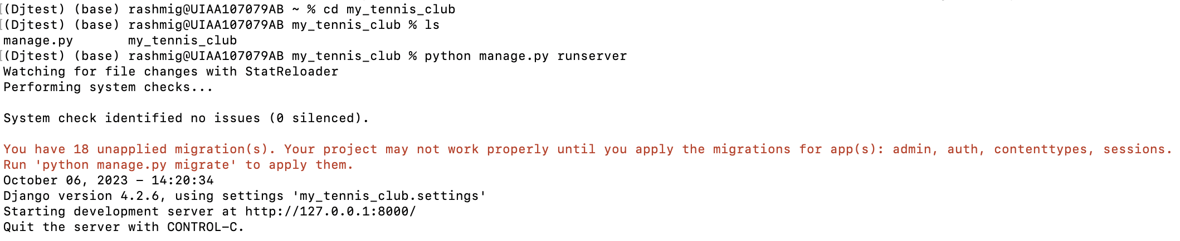
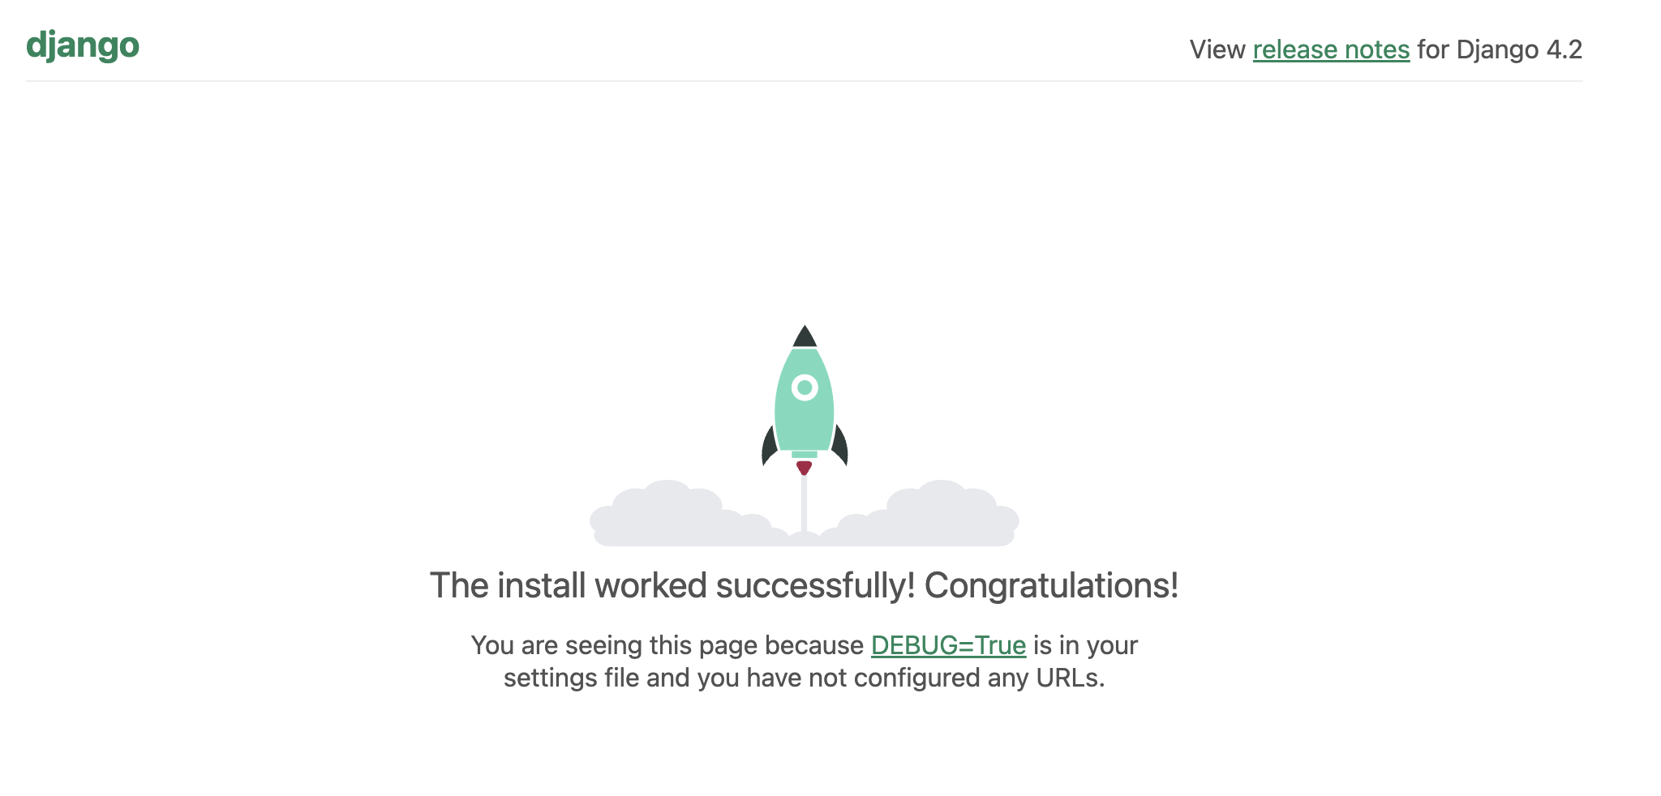
Run the Django Project
Now that you have a Django project, you can run it, and see what it looks like in a browser.
Navigate to the /my_tennis_club folder and execute this command in the command prompt: py manage.py runserver
Open a new browser window and type 127.0.0.1:8000 in the address bar. To quit the server press ctrl+C
Congratulations!! We have a Django project! The next step is to make an app in your project. You cannot have a web page created with Django without an app.

Slide 16
Django Create App
An app is a web application that has a specific meaning in your project, like a home page, a contact form, or a members database.
We will now create an app that allows us to list and register members in a database.
But first, let's just create a simple Django app that displays "Hello World!".

Slide 17
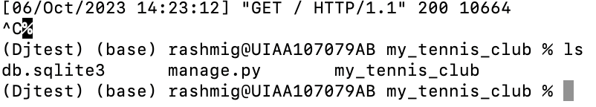
Creating Web App
Let´s name our app members.
Start by navigating to the selected location where you want to store the app, in my case the my_tennis_club folder, and run the command below.
If the server is still running, and you are not able to write commands, press [CTRL] [BREAK], or [CTRL] [C] to stop the server and you should be back in the virtual environment.

Slide 18
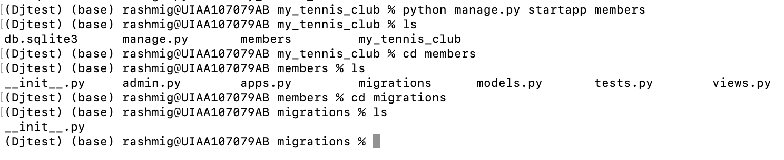
Creating Web App
Django creates a folder named members in my project, with this content:
python manage.py startapp members
These are all files and folders with a specific meaning. You will learn about most of them later. First, take a look at the file called views.py. This is where we gather the information we need to send back a proper response.

Slide 19
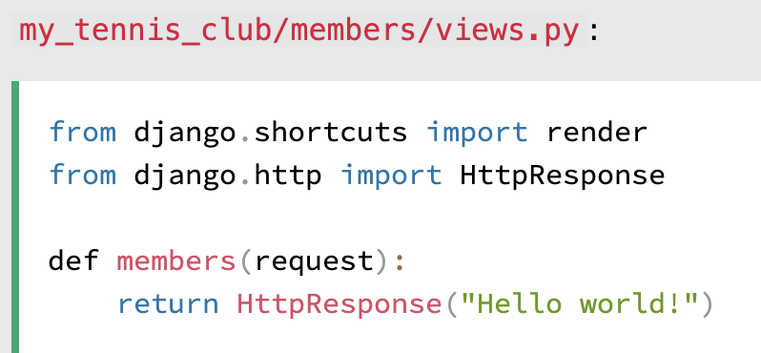
Django Views
Django views are Python functions that takes http requests and returns http response, like HTML documents.
A web page that uses Django is full of views with different tasks and missions.
Views are usually put in a file called views.py located on your app's folder.
There is a views.py in your ”members” folder that looks like this:
my_tennis_club/members/views.py:
python views.py
vim views.py
type :w to enter in write mode
type :q! to enter in quit without saving any changes
Press Esc, type :x and hit Enter to save and quit the program.
Press Esc, type :wq and hit Enter to save the file and exit the editor simultaneously.
Note: The name of the view does not have to be the same as the application. We call it members because I think it fits well in this context.
This is a simple example of how to send a response back to the browser.
But how can we execute the view? Well, we must call the view via a URL.

Slide 20
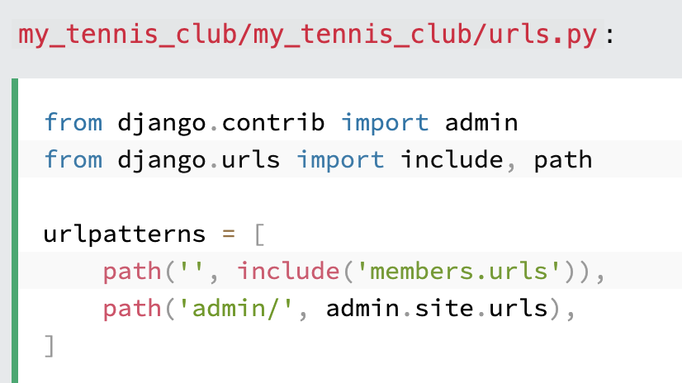
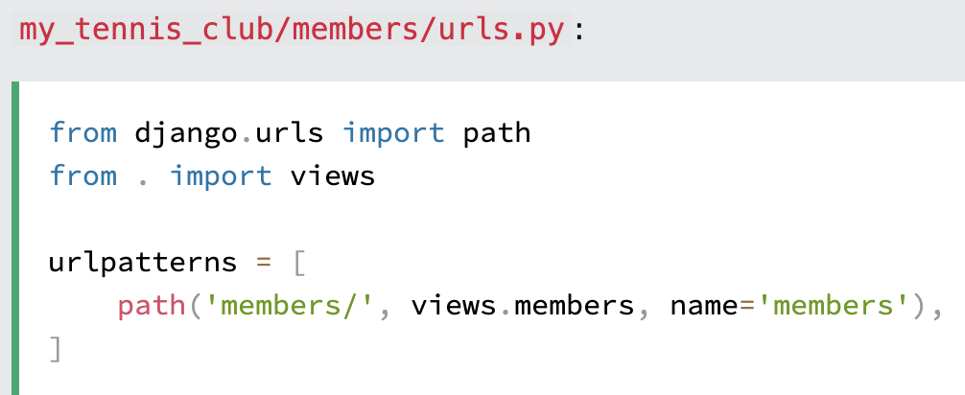
Django URLs
Create a file named urls.py in the same folder as the views.py file, and type this code in it:
The urls.py file you just created is specific for the members application. We have to do some routing in the root directory my_tennis_club as well. This may seem complicated, but for now, just follow the instructions below.
There is a file called urls.py on the my_tennis_club folder, open that file and add the include module in the import statement, and also add a path() function in the urlpatterns[] list, with arguments that will route users that comes in via 127.0.0.1:8000/.
Then your file will look like this:
If the server is not running, navigate to the /my_tennis_club folder and execute this command in the command prompt: py manage.py runserver
In the browser window, type 127.0.0.1:8000/members/ in the address bar.

Slide 21
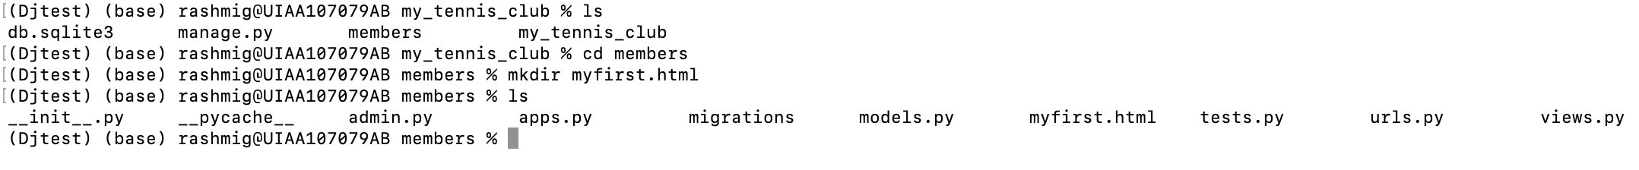
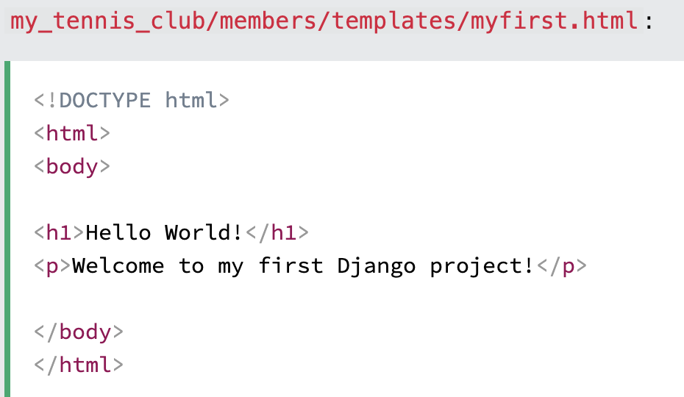
Django Templates
In the Django Intro page, we learned that the result should be in HTML, and it should be created in a template, so let's do that.
Create a templates folder inside the members folder, and create a HTML file named myfirst.html.
The file structure should be like this:
Open the HTML file and insert the following:

Slide 22
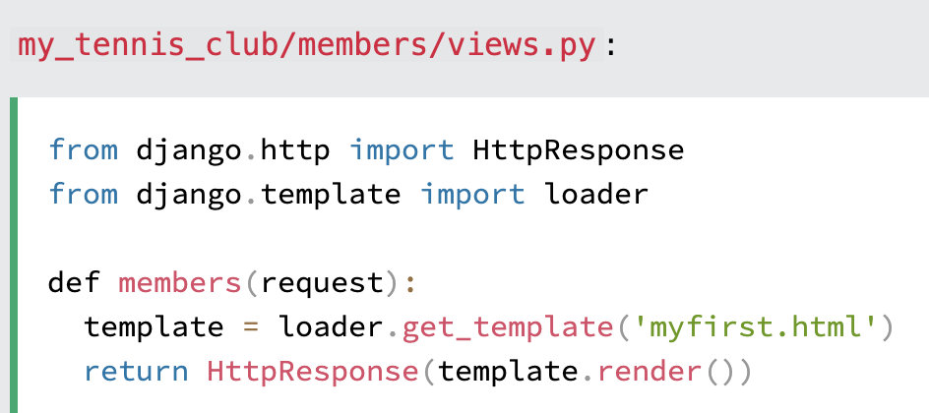
Django Templates: Modify the View
Open the views.py file and replace the members view with this:
More information about templates.. https://docs.djangoproject.com/en/5.2/intro/tutorial06/

Slide 23
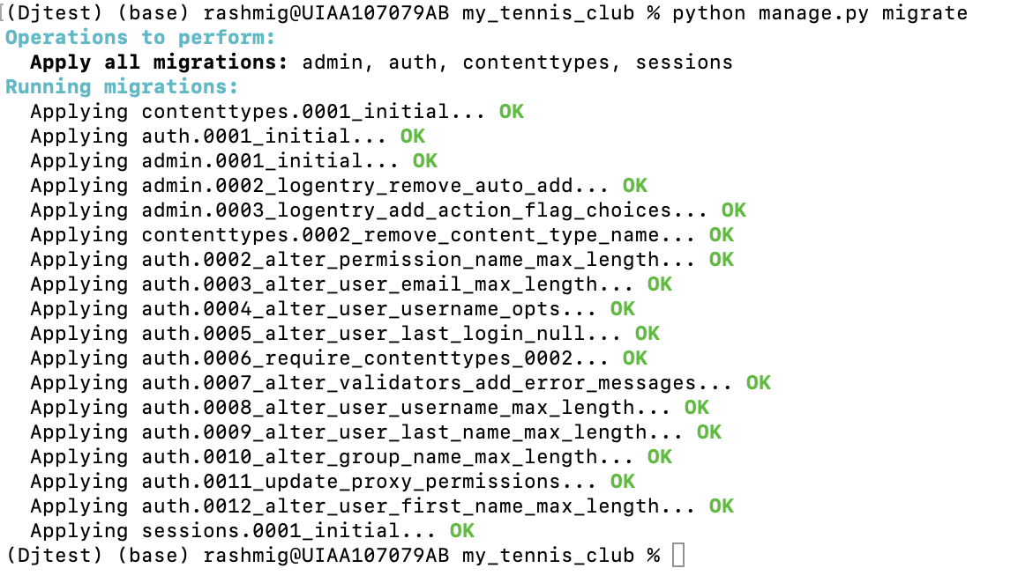
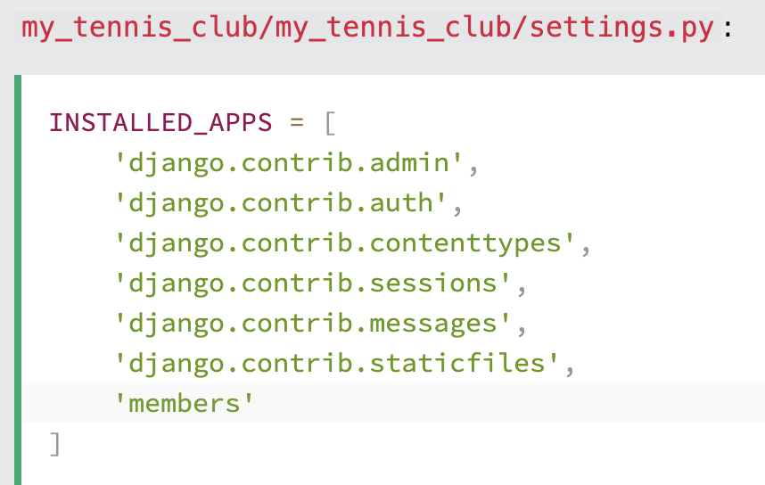
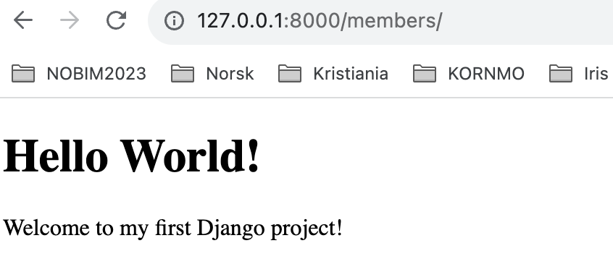
Change Settings
To be able to work with more complicated stuff than "Hello World!", We have to tell Django that a new app is created.
This is done in the settings.py file in the my_tennis_club folder.
Look up the INSTALLED_APPS[] list and add the members app like this:
Then run this command: py manage.py migrate
Which will produce this output:
Start the server by navigating to the /my_tennis_club folder and execute this command: py manage.py runserver
In the browser window, type 127.0.0.1:8000/members/ in the address bar.

Slide 24
Django Models
A Django model is the built-in feature that Django uses to create tables, their fields, and various constraints. In short, Django Models is the SQL Database one uses with Django.
SQL (Structured Query Language) is complex and involves a lot of different queries for creating, deleting, updating, or any other stuff related to a database. Django models simplify the tasks and organize tables into models. Generally, each model maps to a single database table.
Up until now, output has been static data from Python or HTML templates.
Django Models
Create a model in Django to store data in the database conveniently. Moreover, we can use the admin panel of Django to create, update, delete, or retrieve fields of a model and various similar operations. Django models provide simplicity, consistency, version control, and advanced metadata handling. The basics of a model include –
Each model is a Python class that subclasses django.db.models.Model.
Each attribute of the model represents a database field.
With all of this, Django gives you an automatically generated database-access API. Now we will see how Django allows us to work with data, without having to change or upload files in the process.

Slide 25
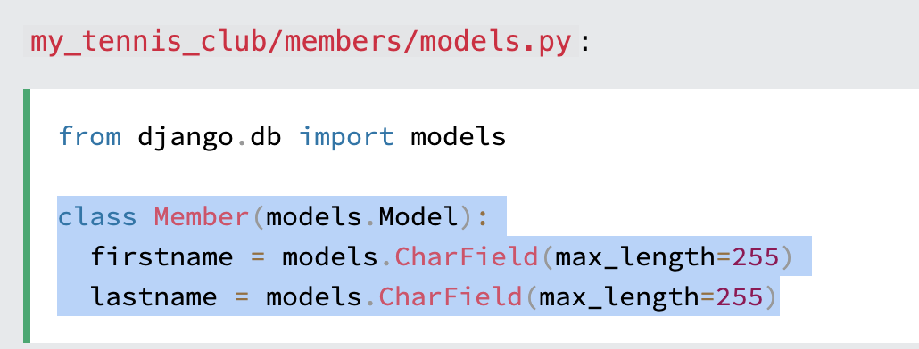
Create Table (Model)
To create a model, navigate to the models.py file in the /members/ folder.
Open it, and add a Member table by creating a Member class, and describe the table fields in it:
The first field, firstname, is a Text field, and will contain the first name of the members.
The second field, lastname, is also a Text field, with the member's last name.
Both firstname and lastname is set up to have a maximum of 255 characters.
SQLite Database
When we created the Django project, we got an empty SQLite database.
It was created in the my_tennis_club root folder, and has the filename db.sqlite3.
By default, all Models created in the Django project will be created as tables in this database.

Slide 26

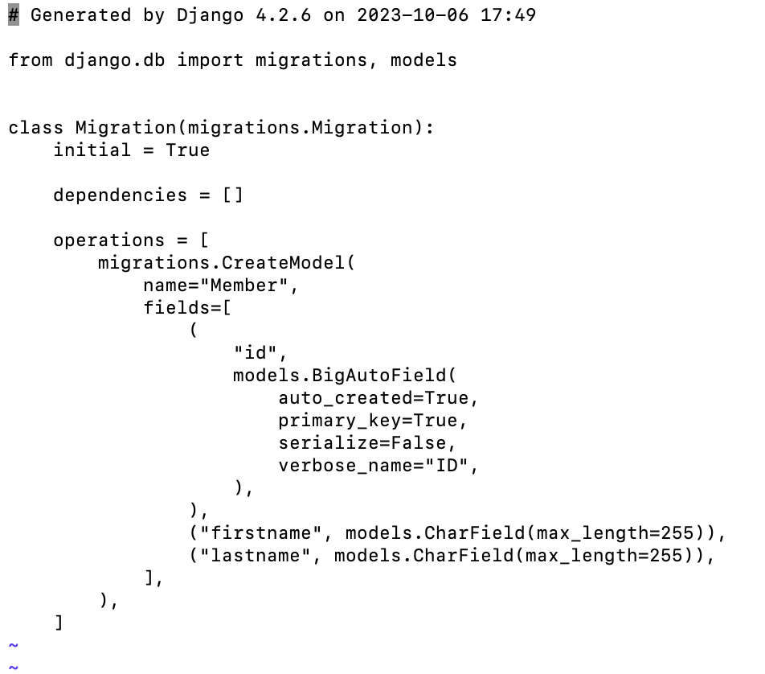
Migrate
Now when we have described a Model in the models.py file, we must run a command to actually create the table in the database.
Navigate to the /my_tennis_club/ folder and run this command: py manage.py makemigrations members
Django creates a file describing the changes and stores the file in the /migrations/ folder:

Slide 27
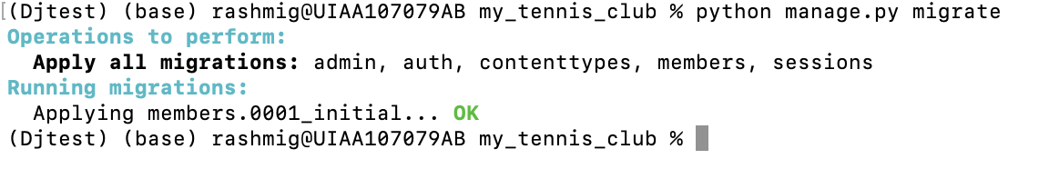
Migrate
Note that Django inserts an id field for your tables, which is an auto increment number (first record gets the value 1, the second record 2 etc.), this is the default behavior of Django, you can override it by describing your own id field.
The table is not created yet, you will have to run one more command, then Django will create and execute an SQL statement, based on the content of the new file in the /migrations/ folder.
Run the migrate command: py manage.py migrate
Which will result in this output:
Now you have a Member table in your database!

Slide 28
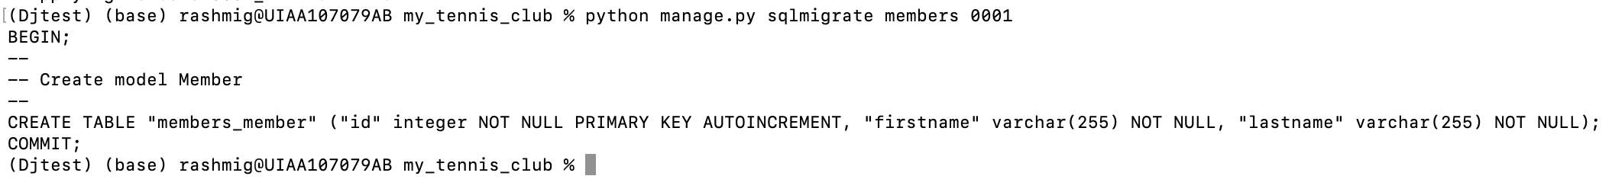
View SQL
As a side-note: you can view the SQL statement that were executed from the migration before.
All you have to do is to run this command, with the migration number: py manage.py sqlmigrate members 0001
Which will result in this output:

Slide 29
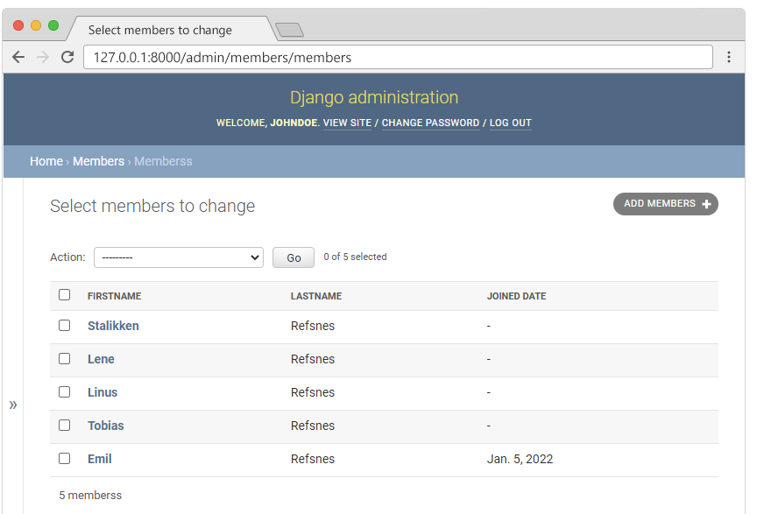
Django Admin
Django Admin is a really great tool in Django, it is actually a CRUD* user interface of all your models!
*CRUD stands for Create Read Update Delete.
It is free and comes ready-to-use with Django:

Slide 30
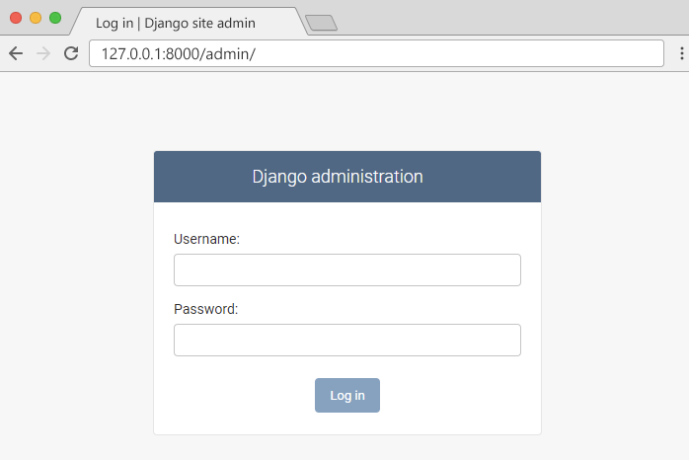
Getting Started
To enter the admin user interface, start the server by navigating to the /yourproject folder and execute this command: py manage.py runserver
In the browser window, type 127.0.0.1:8000/admin/ in the address bar. The result should look like this:

Slide 31
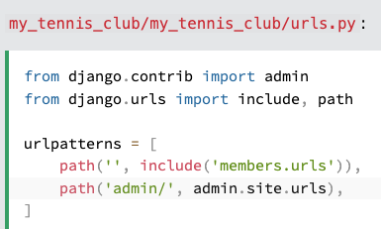
Getting Started
The reason why this URL goes to the Django admin log in page can be found in the urls.py file of your project:
The urlpatterns[] list takes requests going to admin/ and sends them to admin.site.urls, which is part of a built-in application that comes with Django, and contains a lot of functionality and user interfaces, one of them being the log-in user interface.

Slide 32
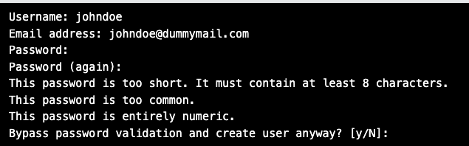
Django Admin - Create User
To be able to log into the admin application, we need to create a user.
This is done by typing this command in the command view:
py manage.py createsuperuser
Which will give this prompt and you must enter: username, e-mail address, (you can just pick a fake e-mail address), and password:

Slide 33
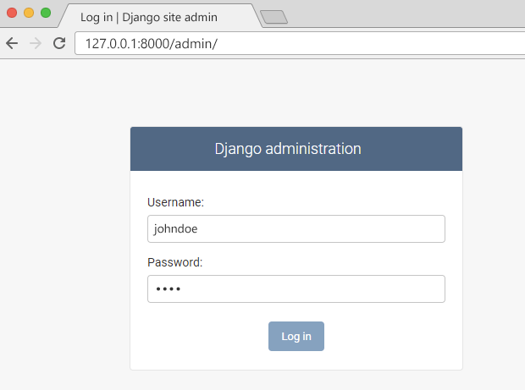
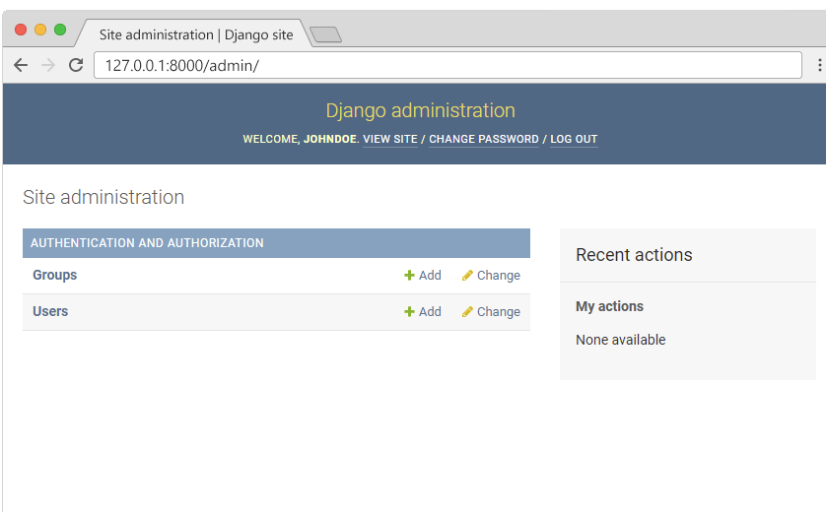
Django Admin - Create User
Now start the server again: py manage.py runserver
And fill in the form with the correct username and password:
Here you can create, read, update, and delete groups and users, but where is the Members model?
Which should result in this user interface

Slide 34
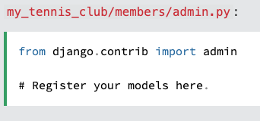
Django Admin - Include Member in the Admin Interface
To include the Member model in the admin interface, we have to tell Django that this model should be visible in the admin interface.
This is done in a file called admin.py, and is located in your app's folder, which in our case is the members folder.
Open it, and it should look like this:

Slide 35
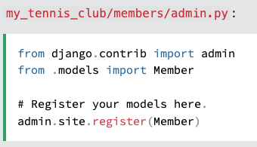
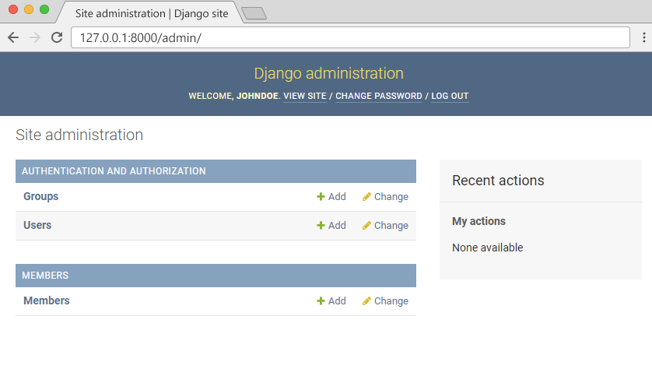
Django Admin - Include Member in the Admin Interface
Insert a couple of lines here to make the Member model visible in the admin page:
Now go back to the browser and you should get this result:

Slide 36
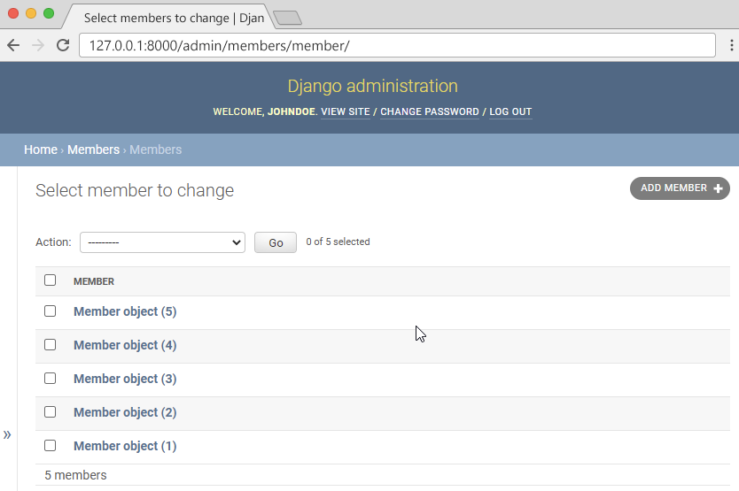
Django Admin - Include Member in the Admin Interface
Click Members and see the five records we inserted earlier in this lecture:

Slide 37
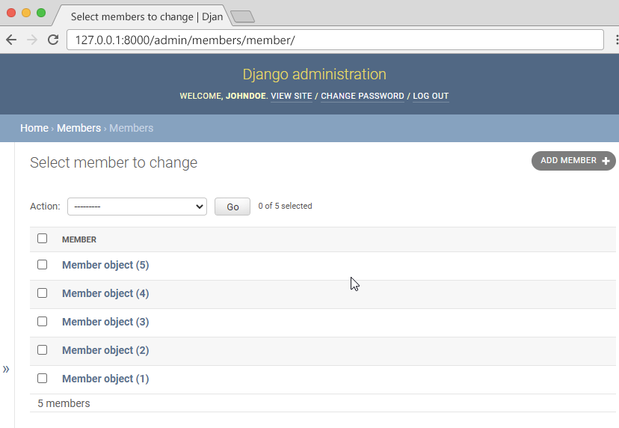
Django Admin - Set Fields to Display
Make the List Display More Reader-Friendly
When you display a Model as a list, Django displays each record as the string representation of the record object, which in our case is "Member object (1)", "Member object(2)" etc.:
To change this to a more reader-friendly format, we have two choices:
Change the string representation function, __str__() of the Member Model
Set the list_details property of the Member Model

Slide 38
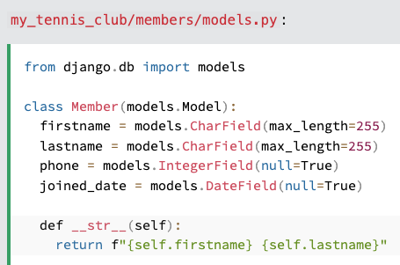
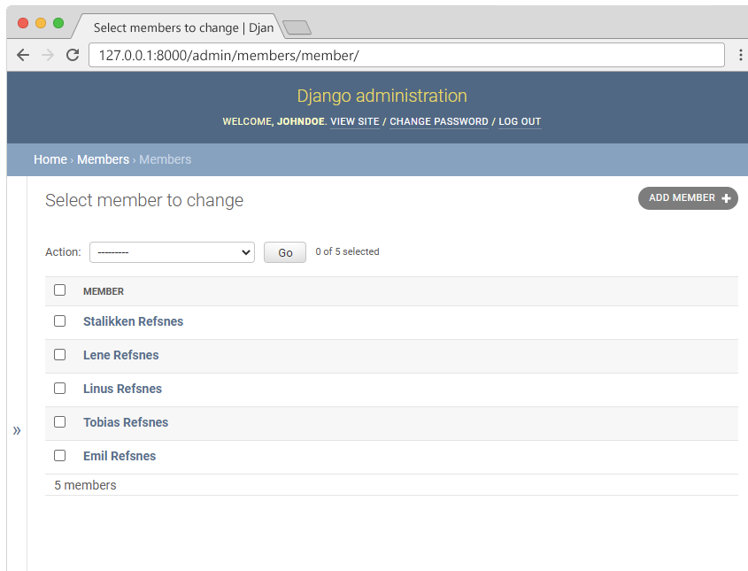
Change the String Representation Function
we have to define the __str__() function of the Member Model in models.py, like this:

Slide 39
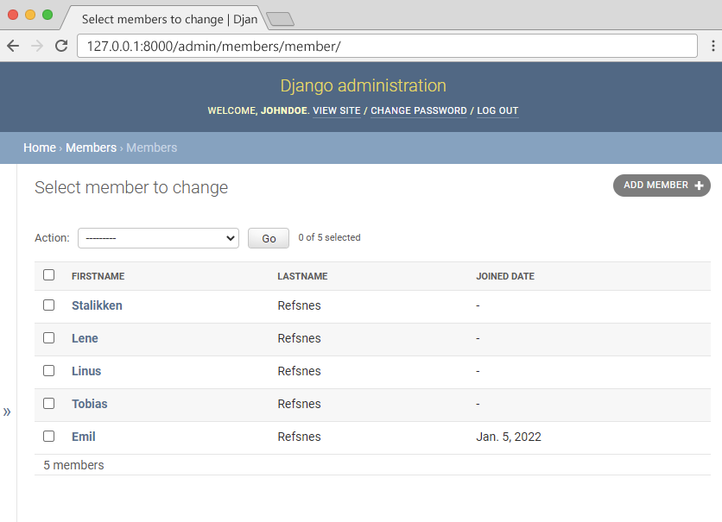
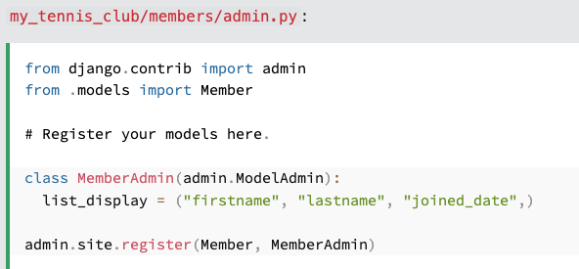
Set list_display
We can control the fields to display by specifying them in a list_display property in the admin.py file.
First create a MemberAdmin() class and specify the list_display tuple, like this:
Remember to add the MemberAdmin as an argumet in the admin.site.register(Member, MemberAdmin).
Now go back to the browser and you should get this result:

Slide 40
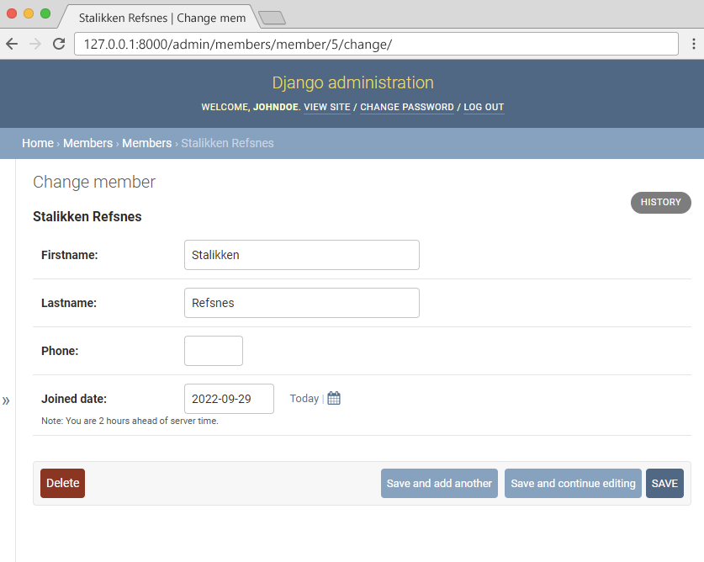
Django Admin – Update, Add, and Delete Members
Now we are able to create, update, and delete members in our database, and we start by giving them all a date for when they became members.
Click the first member, Stalikken, to open the record for editing, and give him a joined_date:

